Slide 1
Pretreatment and Consent Orders - Helping to reach Compliance Randy Bradley, City Corporation Wastewater Operations Manager

Slide 2
Pretreatment programs play an important part in a wastewater treatment plants ability to maintain compliance. This presentation will provide brief history of City corporation’s consent order and how the pretreatment department assisted in some corrective actions

Slide 3
Fall of 2009 ADEQ issued CAO 09-146
Some of the factors that caused the CAO to be issued were:
SSO’s
WW Plant discharge violations – most related to excess flow

Slide 4
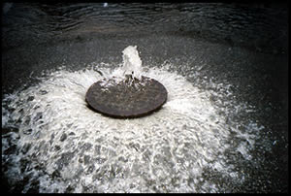
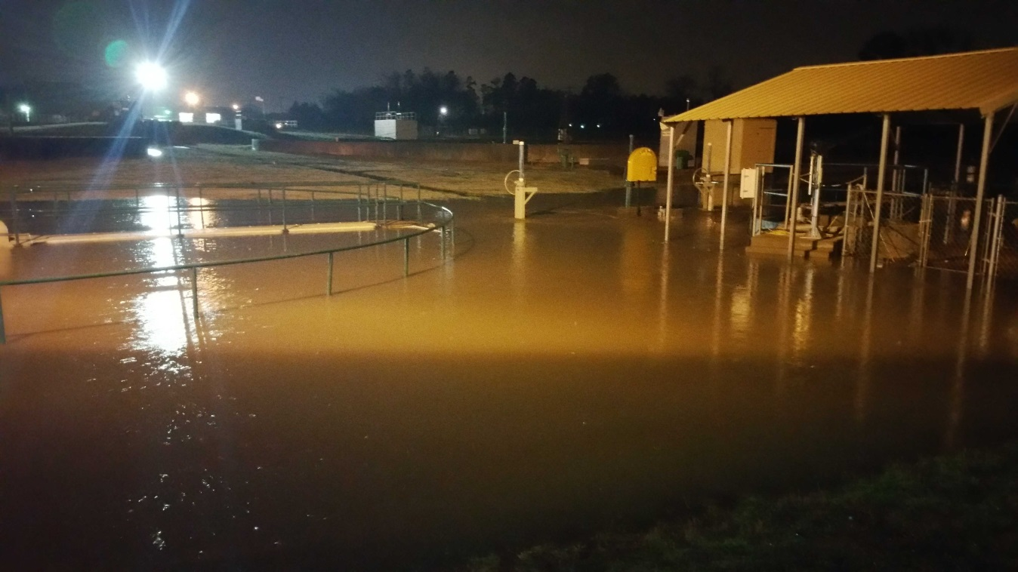

Slide 5
January 2010 City Corporation submitted a Comprehensive Corrective Action Plan
Included in this plan were actions to find and reduce sources of I & I
Pretreatment Department tasked with finding possible I & I from industrial sources.

Slide 6
So what did we do???
Include storm water questions into routine industry inspections
Meeting with all industries asking for assistance and removing any known source of I&I
Cross-connection/Backflow inspections looking for any source of I&I – found leak on fire system line leaking into manhole

Slide 7
What were the results of our efforts??
Ammonia leak at a large industry – found its way to the treatment plant
Businesses pumping storm water to their cleanout
Parking lots, truck and trailer washouts
Others

Slide 8
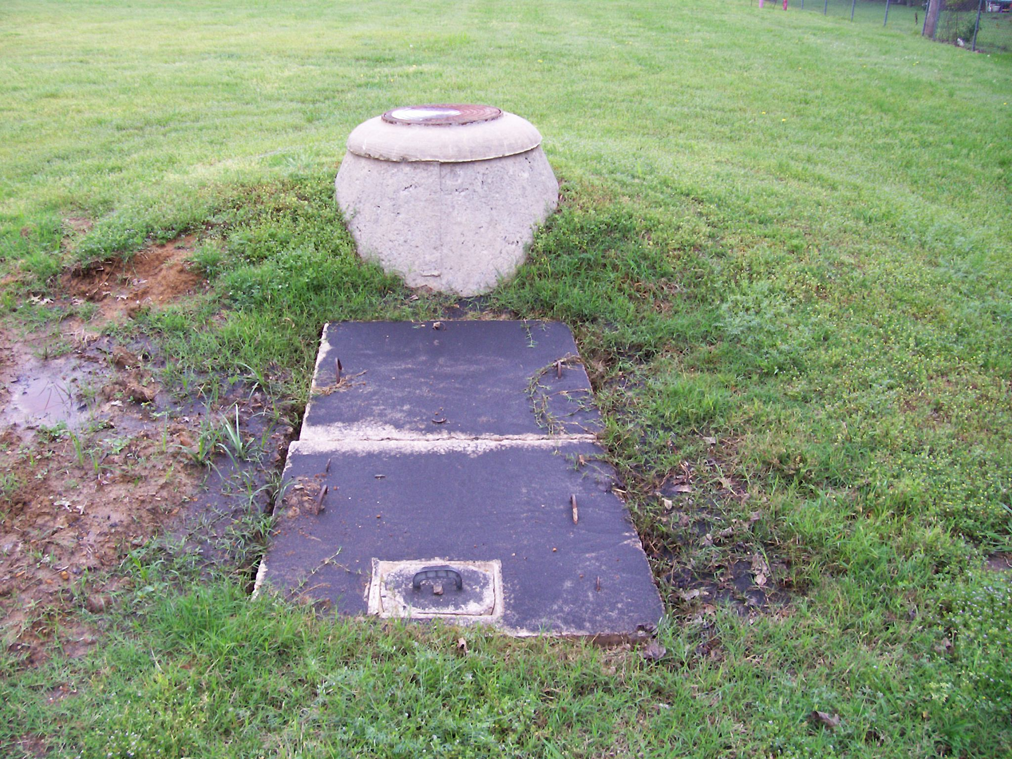

Slide 9
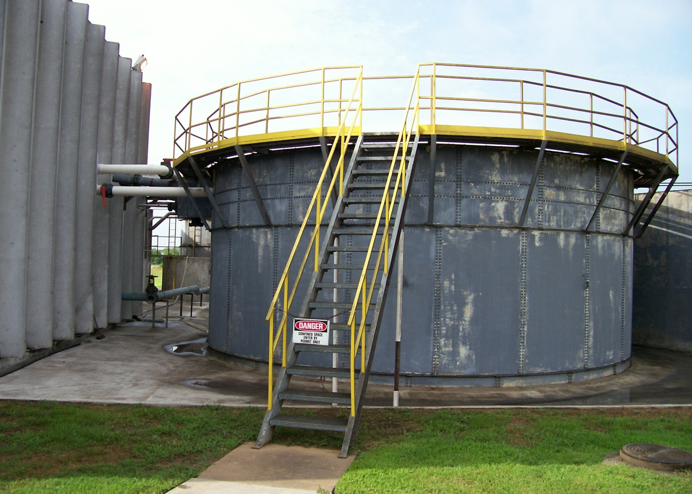

Slide 10
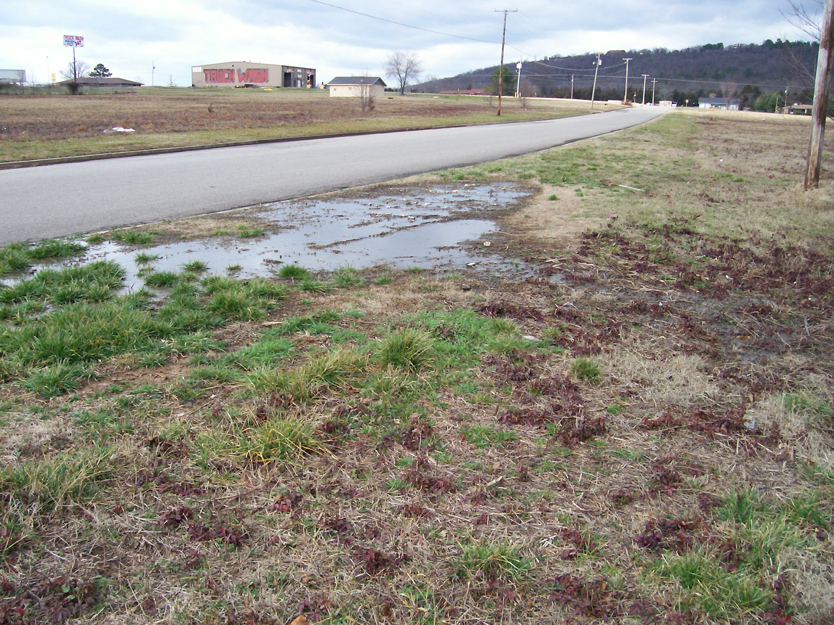

Slide 11
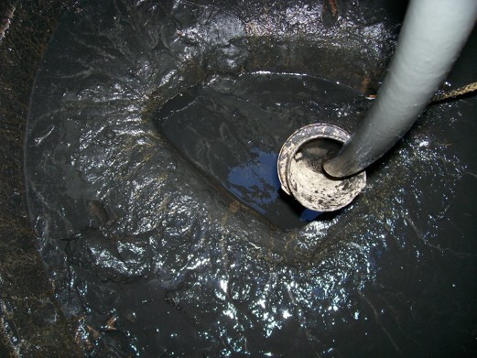

Slide 12
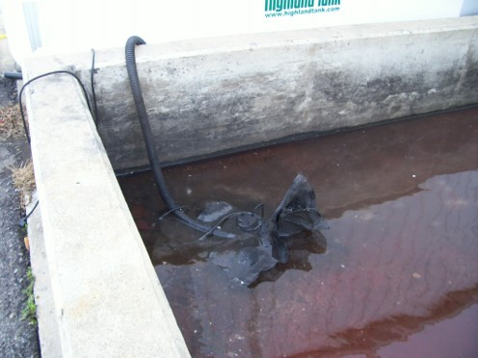

Slide 13
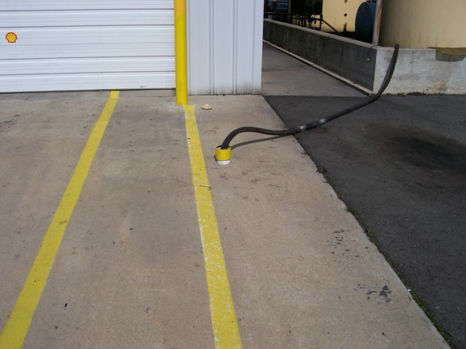

Slide 14
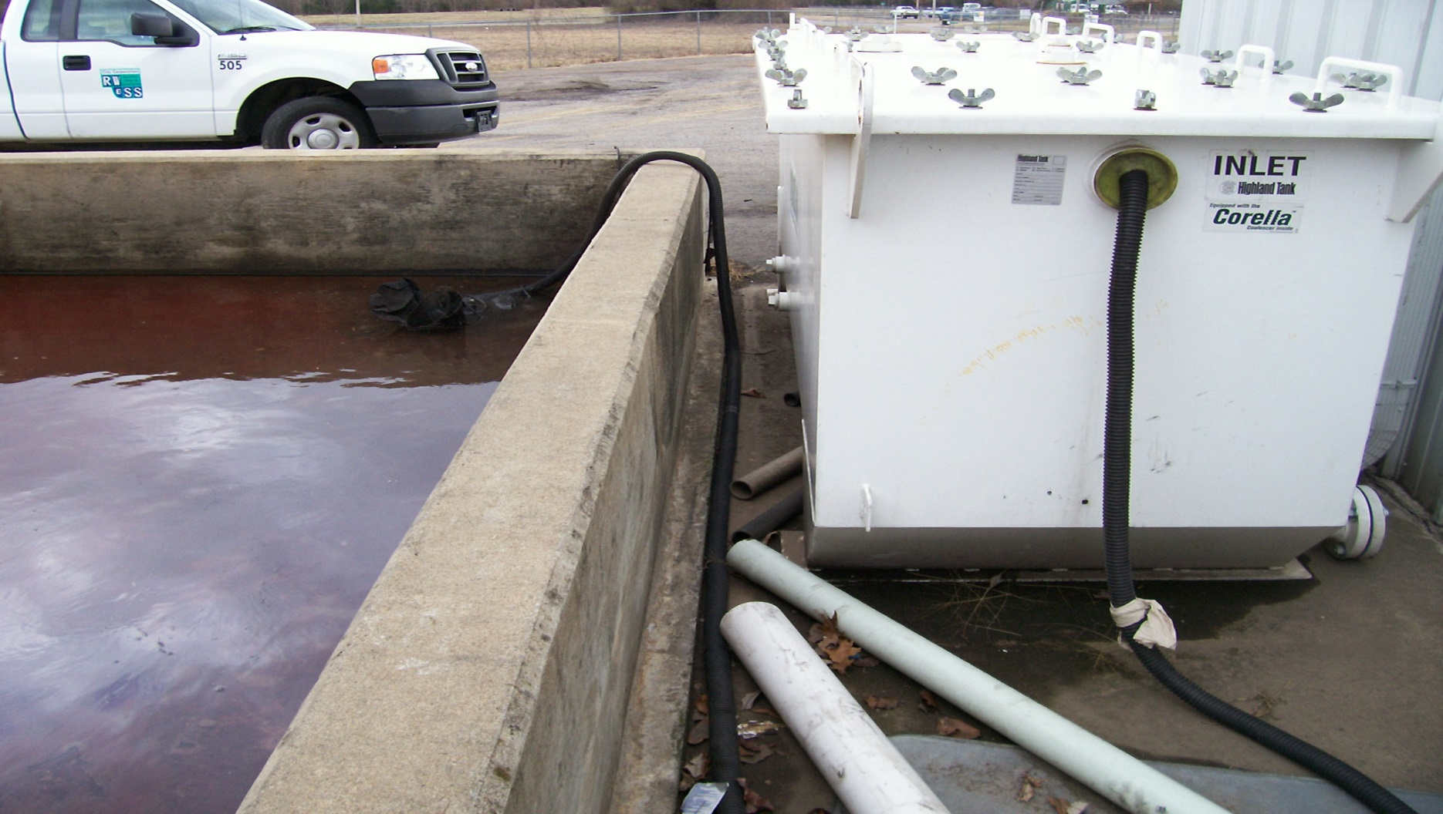

Slide 15
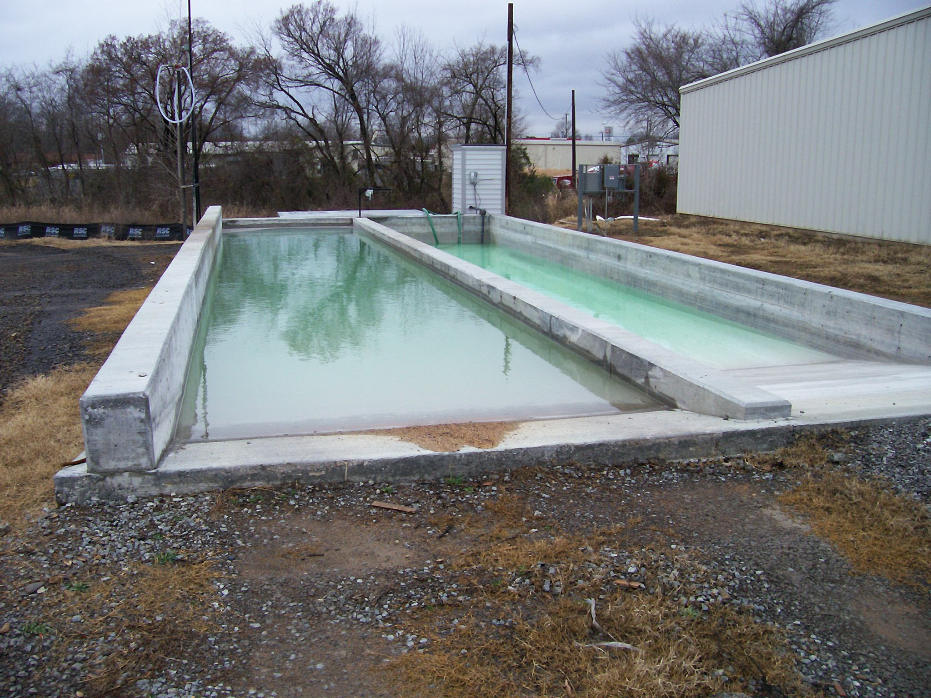

Slide 16
Efforts continue today
Compliance schedule in new discharge permit for local industry to remove all storwwater from facility – currently going to the collection system
Continue to educate businesses and industries on cost associated with stormwater going to collection system
Continue looking !!!

Slide 17
Questions?

